Slide 1


Belief, optimism in sports…
Indian Institute of Technology-Kharagpur
Manas K Mandal, PhD, FNAPsy
Distinguished visiting Professor – IIT Kharagpur

Slide 2
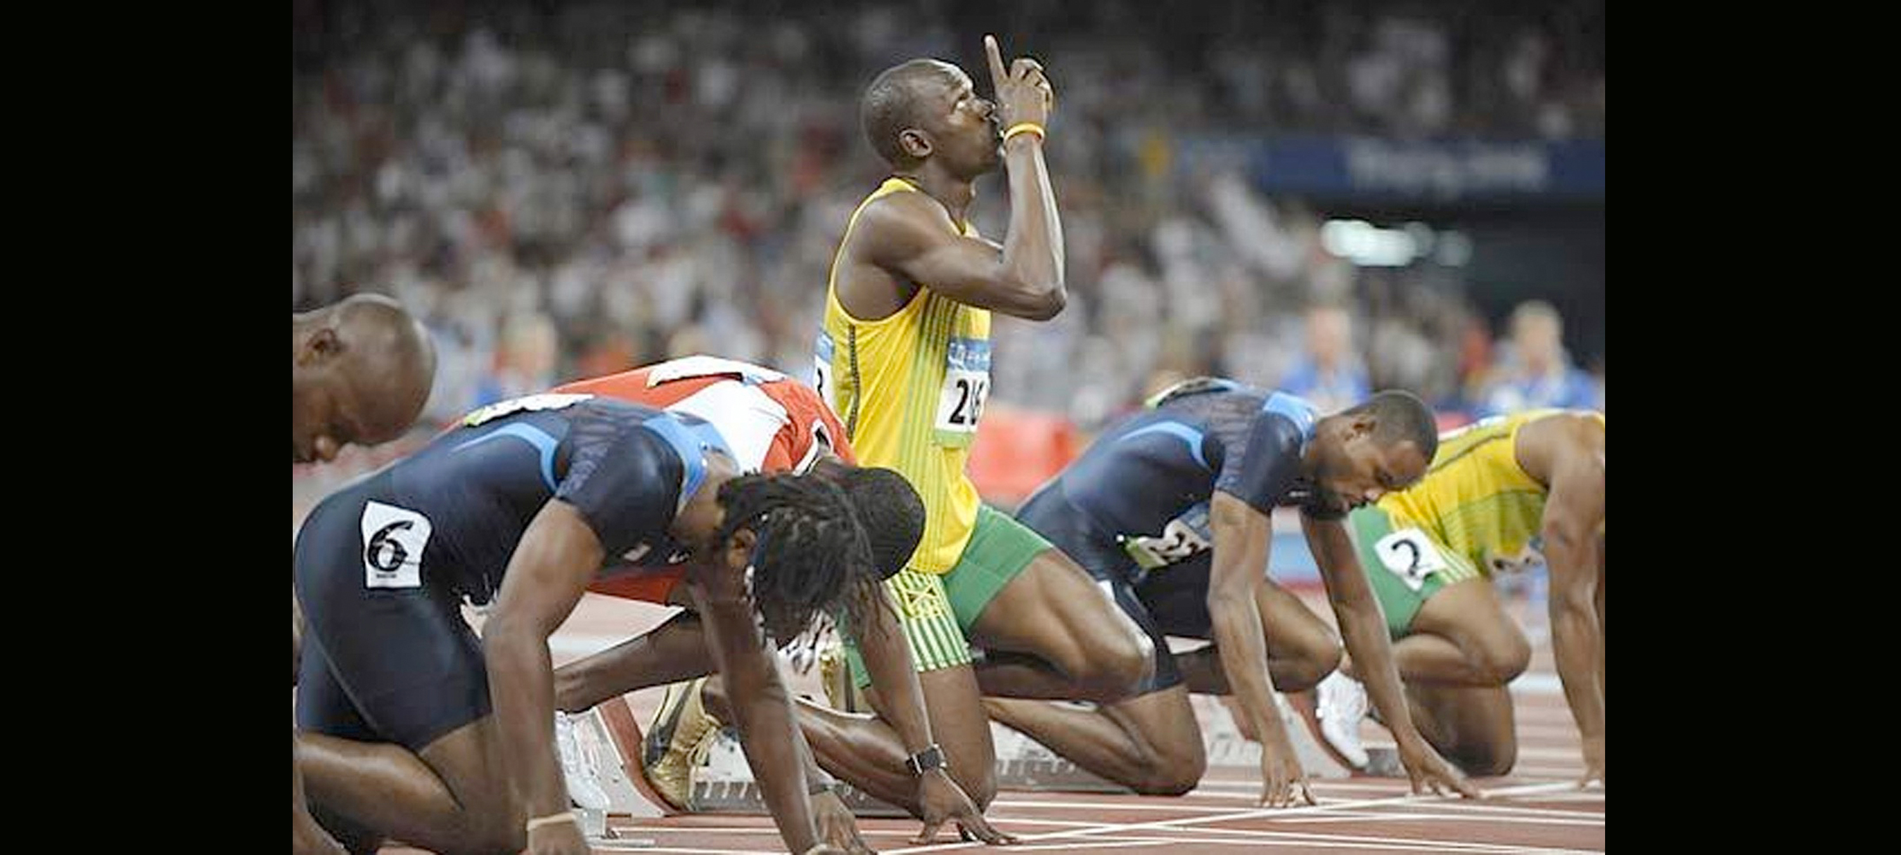
Belief: A state in which someone holds a premise to be true
Indian Institute of Technology-Kharagpur
Is belief a simple thinking error?
Is belief simply a coping mechanism?
Is there a biology that regulate belief?
How far belief & performance are related?

Slide 3
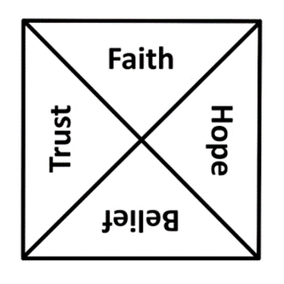
Subtle differences
Indian Institute of Technology-Kharagpur
Trust: …is a reliance or confidence placed on someone or something based on integrity, reliability or ability
Belief:… refers to accepting something as true or real without having evidence behind
Faith:…involves a strong, unwavering belief or trust, often associated with spiritual contexts and goes beyond rationality
Hope:…an optimistic and positive expectation about the future

Slide 4
Primal belief
Indian Institute of Technology-Kharagpur
…an individual’s most basic belief about the general character of the world (Clifton, 2021)
Unidentified beliefs shape our behavior – often dramatically via ambiguity interpretation (McNamara, et al., 2006)

Slide 5
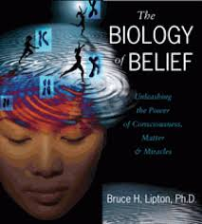
Indian Institute of Technology-Kharagpur
The Biology of Belief
The common idea is that gene determines our physical & mental characteristics
A person’s perception, not genetic programming determines our behavior
Our beliefs select our genes, that determines our behavior
Bruce Lipton

Slide 6
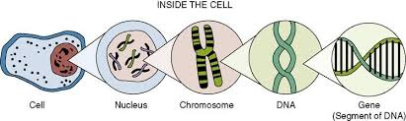
Indian Institute of Technology-Kharagpur
Every cell has the gene whose function is to rewrite or adapt genes as necessary
Mutation happens in response of environmental signals
Environmental signal is different from organism’s perception of signals
Beliefs act as a filter in between… that determine which gene to be activated in a situation
So, our belief rewrites gene
The Biology of Belief

Slide 7
Indian Institute of Technology-Kharagpur
Human senses are programmed in a way to determine which gene to be activated in a situation
Two classes of program : growth or protection
When a person gets love, growth genes are activated; protection genes are activated when encounters fear
Negative perception activate protection genes, triggering fight or flight response
The Biology of Belief
The biology of belief: Bruce Lipton

Slide 8
Indian Institute of Technology-Kharagpur
When a person perceives negative environment, blood flows away from vital organ & is directed towards limbs, compromising immune system
Negative thoughts boost reflexes, at the cost of higher order mental functions
Beliefs act as a filter between real world & biology
So, our choosing of beliefs determine what genes are to be expressed?
The Biology of Belief
The biology of belief: Bruce Lipton

Slide 9
Indian Institute of Technology-Kharagpur
Why is belief important in sports
When a sportsperson believes in their ability there is a higher chance of having successful performance
The more success that comes, the more a sportsperson will believe in their ability to perform. The two feed each other
Beliefs are the architects of our reality, sculptors of our success. These internal narratives shape how we perceive and interact with the world

Slide 10
Beliefs influence body’s response
Indian Institute of Technology-Kharagpur
Placebo effects from inert treatments on sports performance are well documented (Beedie et al., 2006; Beedie & Hettinga, 2020).
So, belief in a supposedly performance-enhancing intervention, particularly novel ones, can improve performance regardless of real treatment effects (Halson & Martin, 2013)

Slide 11
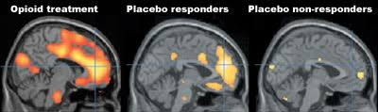
The Science of Belief
Indian Institute of Technology-Kharagpur
Strong negative relationship between positive belief & depression
Positive belief improves immune system
They have better coping strategies to deal with adversities
Believing in cure produces real bodily changes

Slide 12
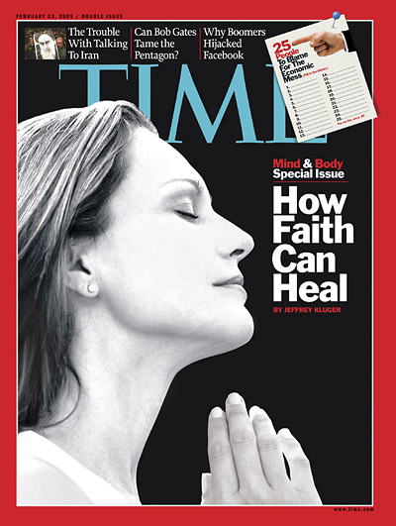
Some research findings…
Indian Institute of Technology-Kharagpur
Faith & longevity have relation: 2-3yrs of additional life with religious faith
HIV patients who pray have higher immunity cells
People who believe in loving God fare better after an illness than people who believe in punitive God

Slide 13
‘a belief that the outcome of an endeavor will be positive’
Indian Institute of Technology-Kharagpur
Optimism
Are there different kinds of optimists?
Is it a gift of nature only handful are blessed with?
How far optimism & health are related?
Does optimism help in making decisions?
.

Slide 14
Optimism: why is it important?
Indian Institute of Technology-Kharagpur
Optimism is not a naive assumption that everything is always going to be fine… is a mindset, characterized by maintaining positive expectations for important future outcomes
It is the stories you tell yourself, and the way you interpret the circumstances and events of your life
Optimism, and the anticipation that comes with it, makes us happy
It is the most powerful predictor of resilience
Positive emotions can undo the effects of negative experiences.

Slide 15


Dispositional optimism
Indian Institute of Technology-Kharagpur
Optimism-Pessimism: Type - I
Dispositional pessimism

Slide 16
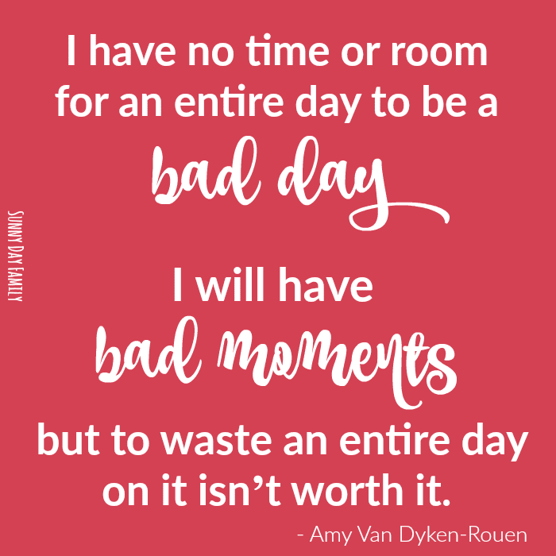

Indian Institute of Technology-Kharagpur
Optimism-Pessimism: Type - II
Explanatory optimism
Explanatory pessimism

Slide 17
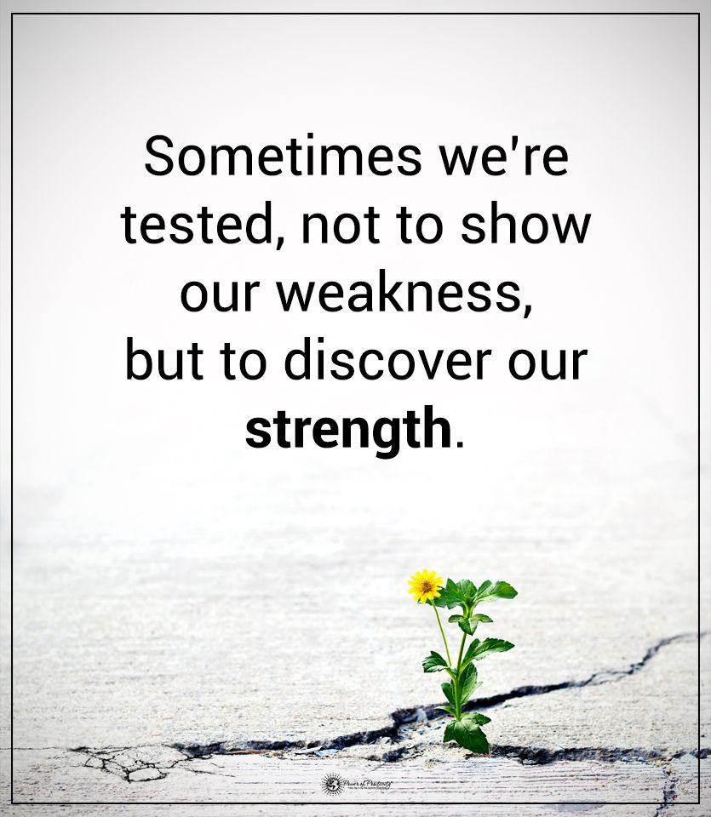
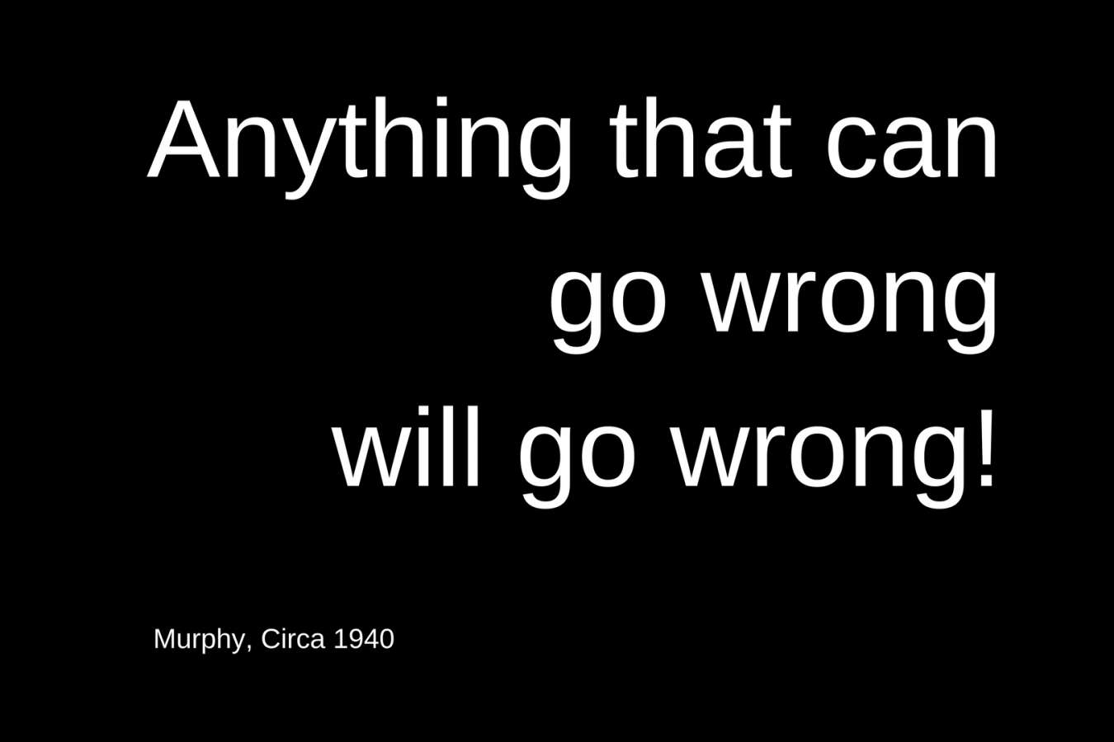
Indian Institute of Technology-Kharagpur
Optimism-Pessimism: Type - III
Strategic optimism
Strategic pessimism

Slide 18
Explanatory style in sports
Indian Institute of Technology-Kharagpur
Positive events: internal (within persons control) stable (this reason will always be the there) and global (effects everything) causes
we won the game because I am talented
Negative event: external (without person’s control), unstable (the reason is only temporary) and specific (only effects that certain situation) factors
We lost the game because the other team scored a lucky goal

Slide 19
Why is it good for sportsperson to be Optimistic: Research evidence
Indian Institute of Technology-Kharagpur
Better performance and less variability (football; Gordan & Kane, 2001)
Overcome adversities, motivation, & persistence. (Carver et al., 1979)
More wins (basketball, baseball: Rettew & Reivich, 1995)
Little variability (Swimming: Seligman et al., 1990)
Less likely to burn out (Tsai, Chen & Kee, 2007)

Slide 20

How to build optimistic thinking?
Indian Institute of Technology-Kharagpur
Stop listening to yourself via mindset and start talking to yourself with intention and purpose
Interpretation is more important than preparation
It is important to understand ‘optimism bias’

Slide 21
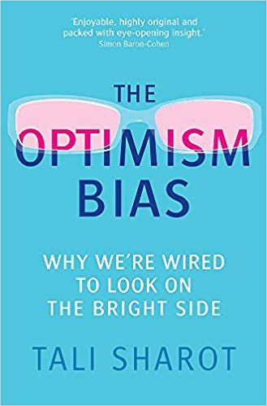
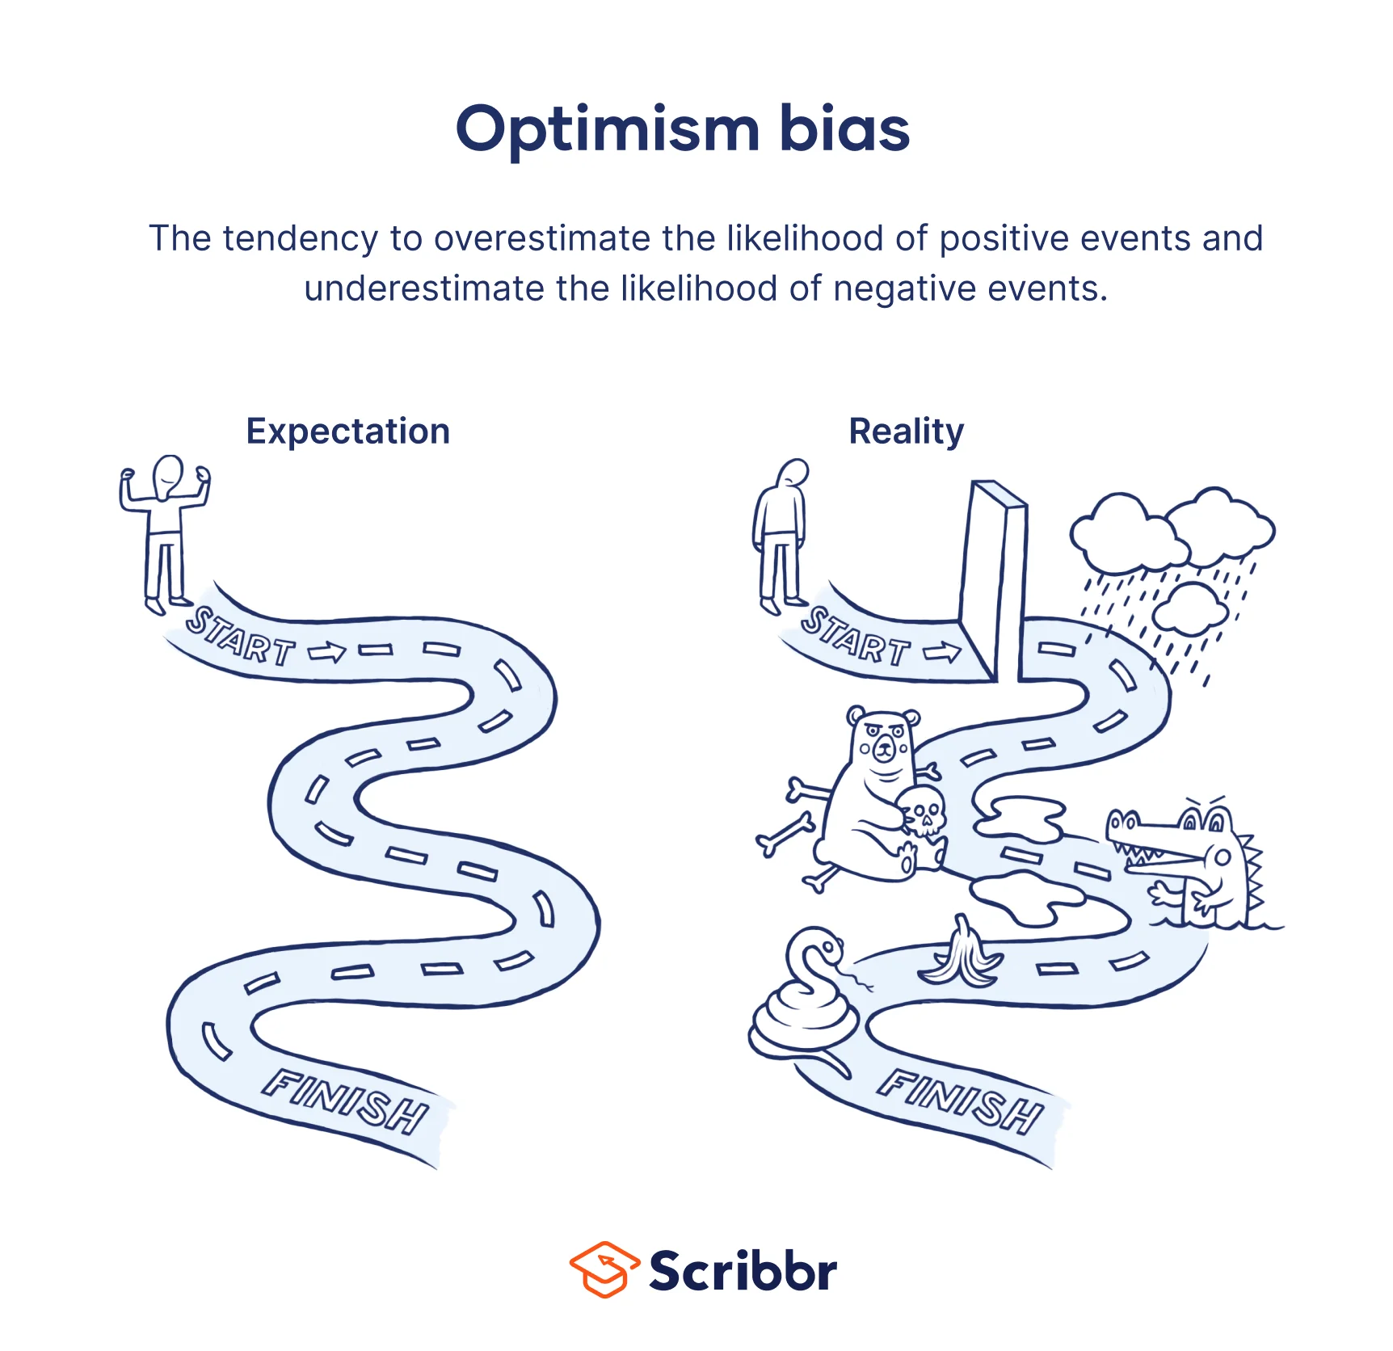
Indian Institute of Technology-Kharagpur
Optimism bias: An expectancy that good, …, will occur, without evidence to support
Do we expect to live longer & be healthier than average?
Do we overestimate the prospect of success every time?
Do we make more mistakes by becoming optimistic
unrealistically?
Do we have selective estimation error about future?

Slide 22
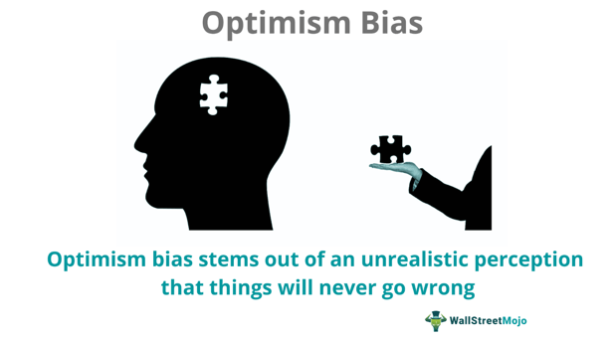
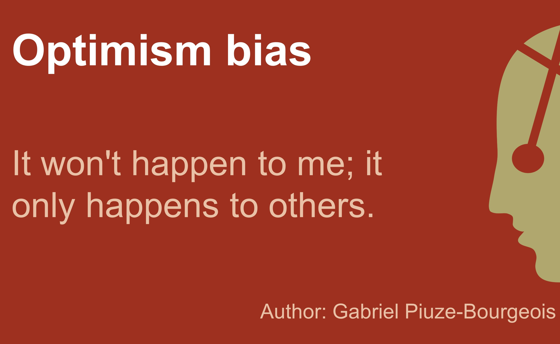
Optimism bias…when it increases
Indian Institute of Technology-Kharagpur
When things or events are thought to be under individual’s direct control
When there is a sense of uncertainty
When there is selective inattention to perceived risk

Slide 23
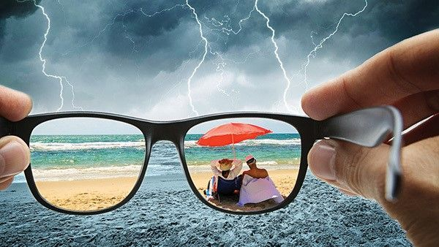
Optimism bias…negative consequences
Indian Institute of Technology-Kharagpur
The bias change's objective reality
Underestimating risk reduces precautionary behavior like buying medical insurance
Promote harmful behavior like over-eating, smoking
Temporal discounting like rewarding at present but costly in future

Slide 24
Optimism bias in sports
Indian Institute of Technology-Kharagpur
Fans & sports reporters create optimism bias
The team will perform well because I am a good coach
Optimism bias is the strongest when we believe we have control in games
https://www.ted.com/talks/tali_sharot_the_optimism_bias/transcript

Slide 25
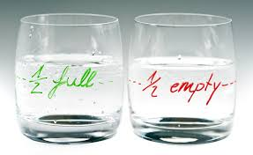
Indian Institute of Technology-Kharagpur
‘Optimism should be used as a stimulant, not as an intoxication for misplaced hope’ (Aziz, 2018)

